Slide 1


HL-Pow: A Learning-Based Power Modeling Framework for High-Level Synthesis
Zhe Lin¹, Jieru Zhao¹, Sharad Sinha², Wei Zhang¹
¹Hong Kong University of Science and Technology (HKUST)
²Indian Institute of Technology (IIT) Goa

Slide 2
Outline
Introduction
Related Work
Power Modeling Framework
Design Space Exploration
Conclusion

Slide 3
Outline
Introduction
Related Work
Power Modeling Framework
Design Space Exploration
Conclusion

Slide 4
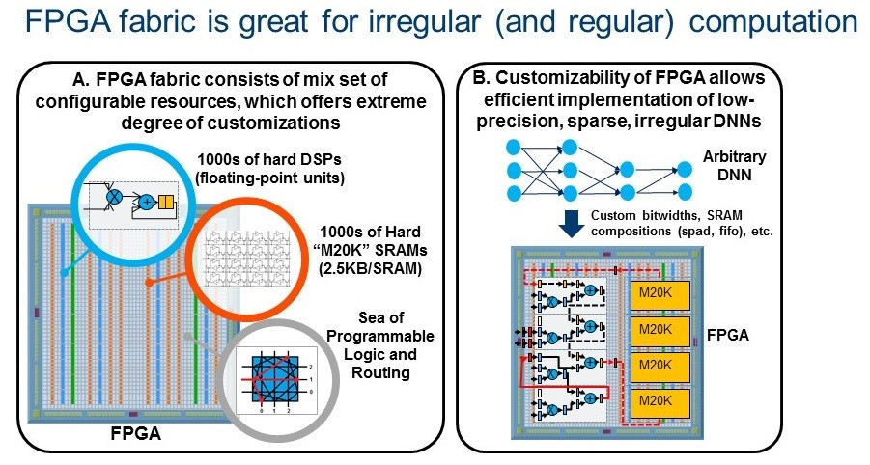
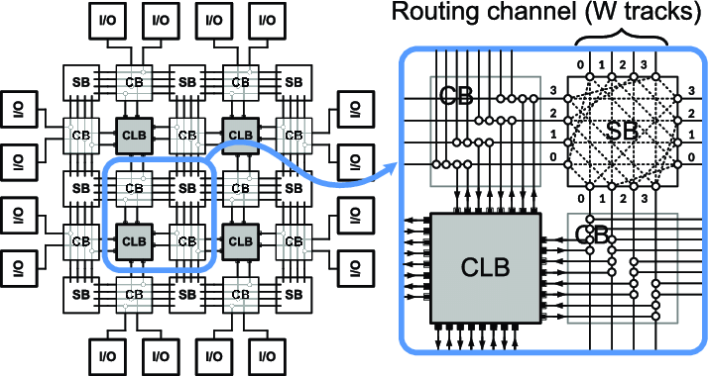
FPGA Overview
Field-Programmable Gate Array (FPGA)
Customizable logic blocks and wirings
On-chip memory and arithmetic units

Slide 5
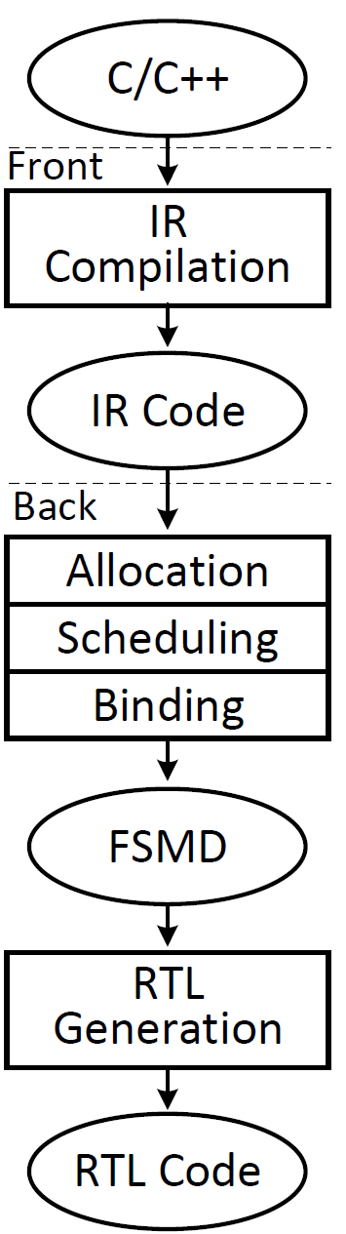
High-Level Synthesis (HLS)
C/C++ → hardware description languages
Front-end
Intermediate representation (IR) generation
Bitwidth reduction, loop unrolling, etc
Back-end
Resource allocation, scheduling, binding
Register-transfer level (RTL) code generation
Directives to tune latency/resource
Loop unrolling: duplicate loop copies
Loop pipelining: pipeline stages
Array partitioning: split memories

Slide 6
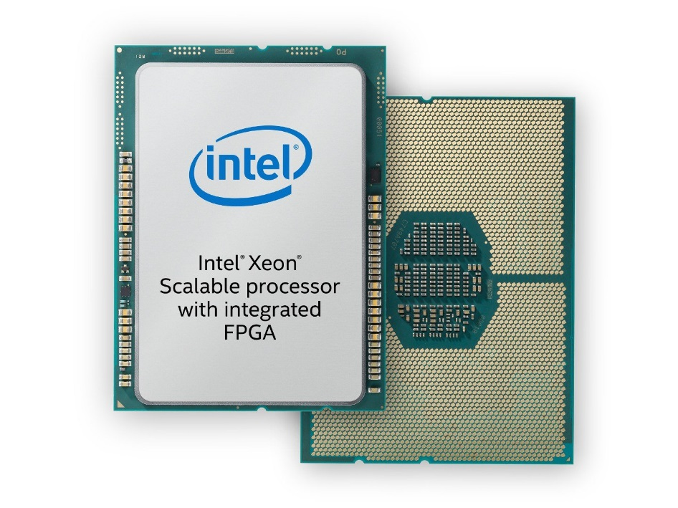
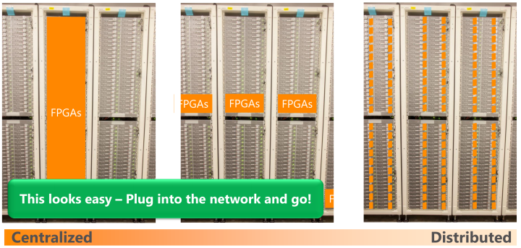
FPGA Power Issue
A key design constraint
Single FPGA: increase with size and density; heterogeneous systems
Multiple FPGAs: large-scale applications / datacenters

Slide 7
FPGA Power Evaluation
Go through synthesis, placement and routing → a long time
Estimation: gate-level power analysis
Measurement: onboard measurement
Design-time power analysis:
Trade off between performance / resource / power
→ Large run-time overheads
Logic synthesis
Gate-level netlist
Power estimation
RTL design
Placement
Bitstream
Power measurement
Routing

Slide 8
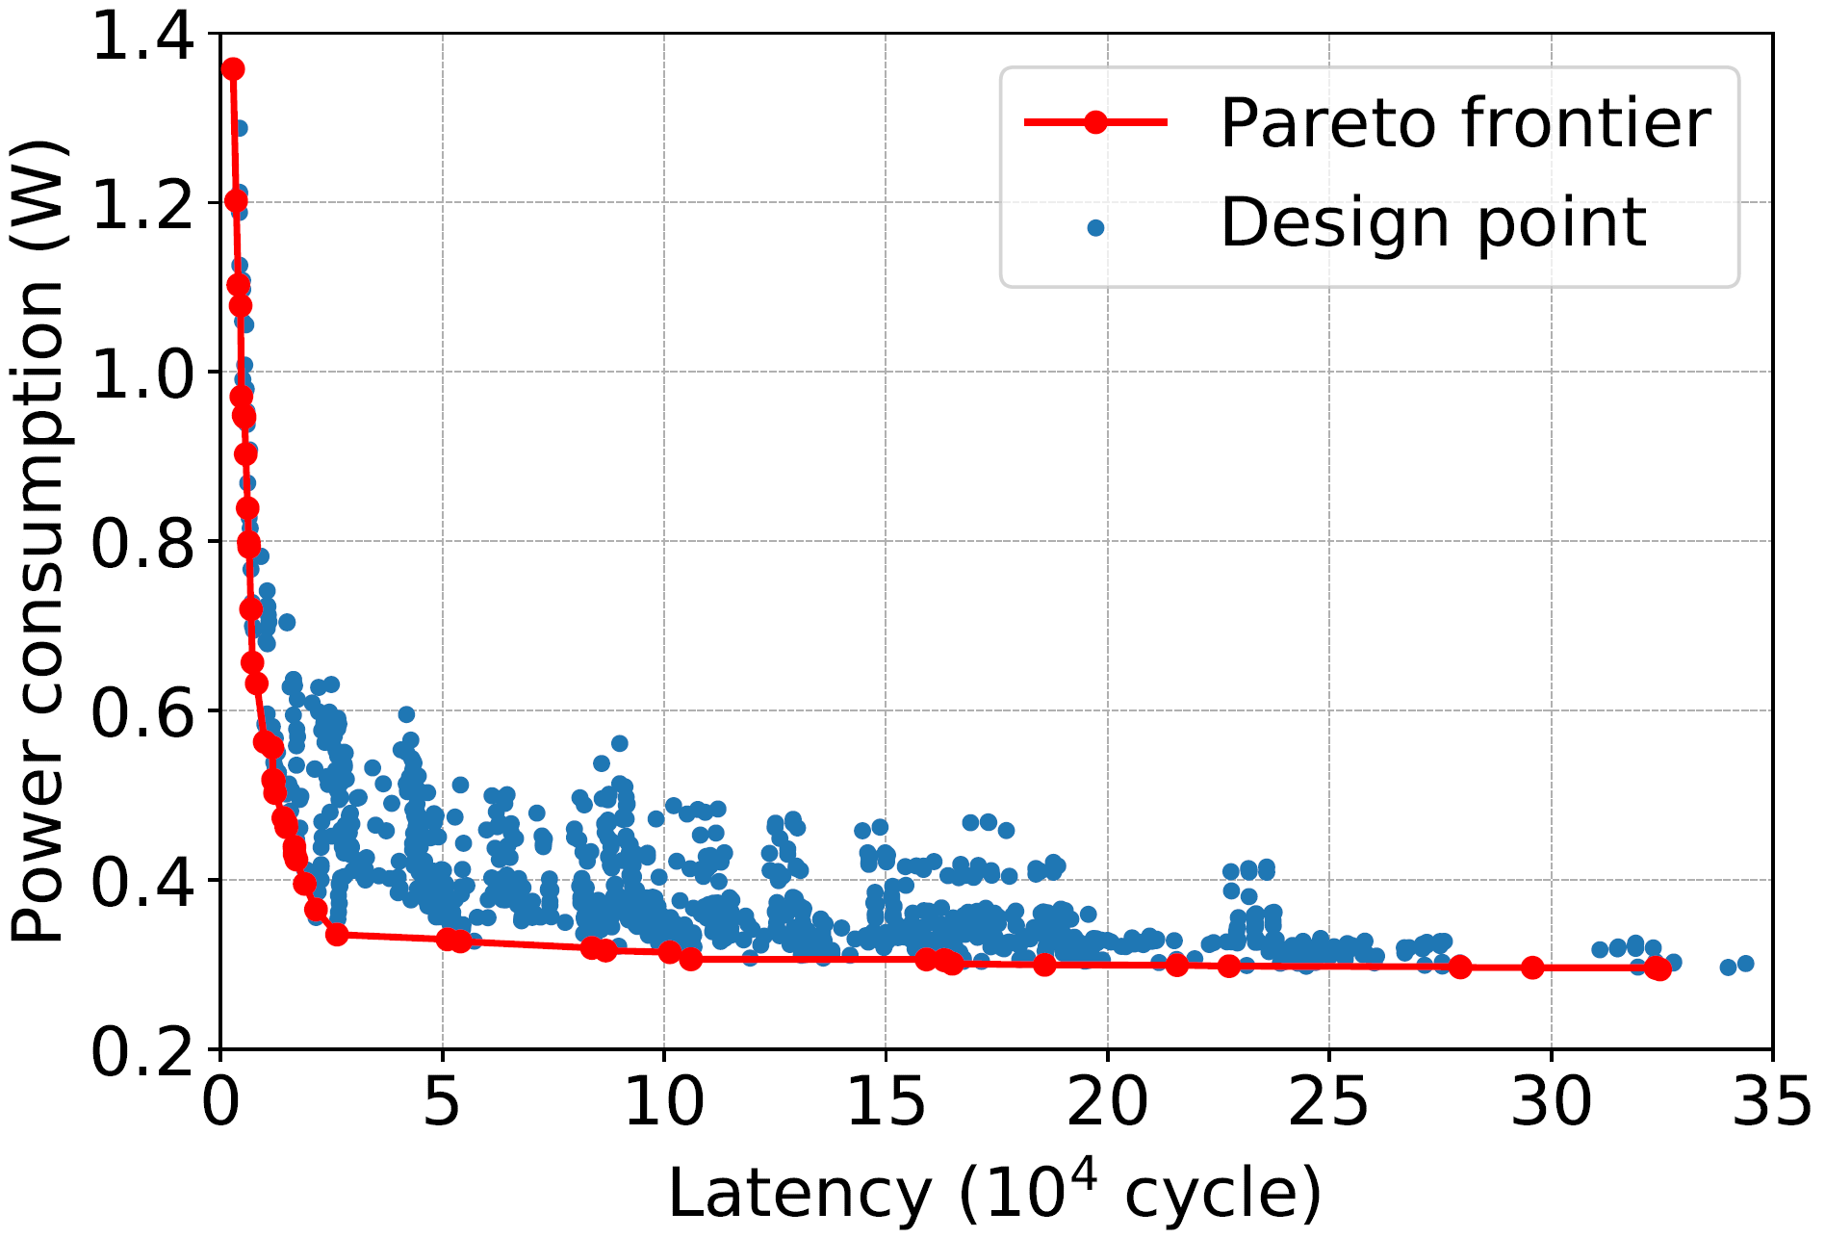
Contributions
HL-Pow framework: Fast and early-stage power estimation
DSE framework: Power-oriented design space exploration (DSE)

Slide 9
Outline
Introduction
Related Work
Power Modeling Framework
Design Space Exploration
Conclusion

Slide 10
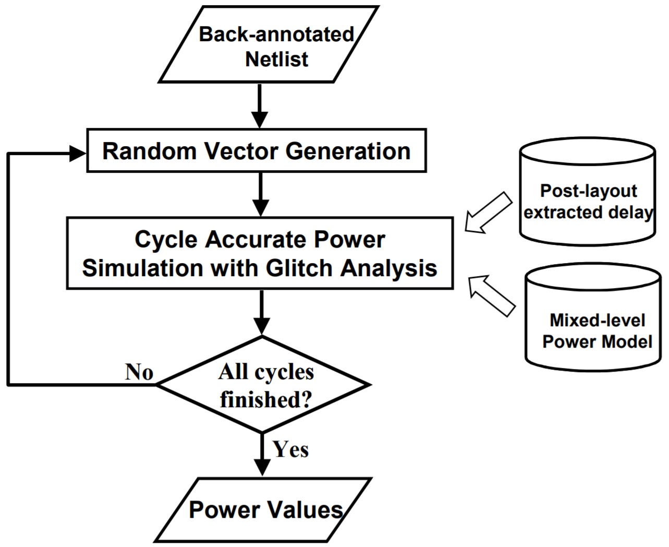
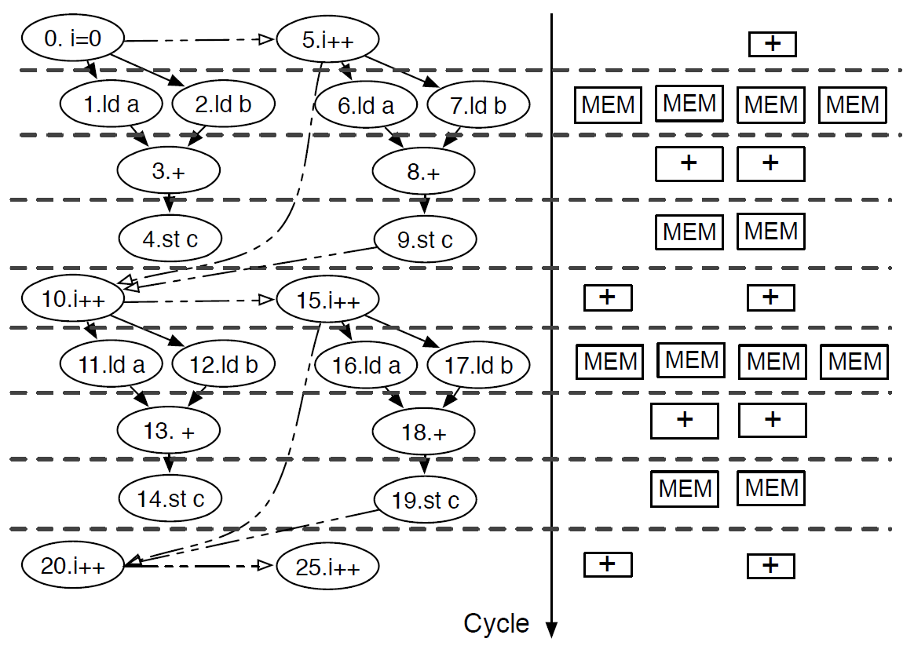
Low-Level Power Modeling
Component-based power characterization
Power library: input-power mapping per component [shao et al, 2014]
Consider variations in bitwidths/cell selection, etc
Aggregation of component power for design power

Slide 11
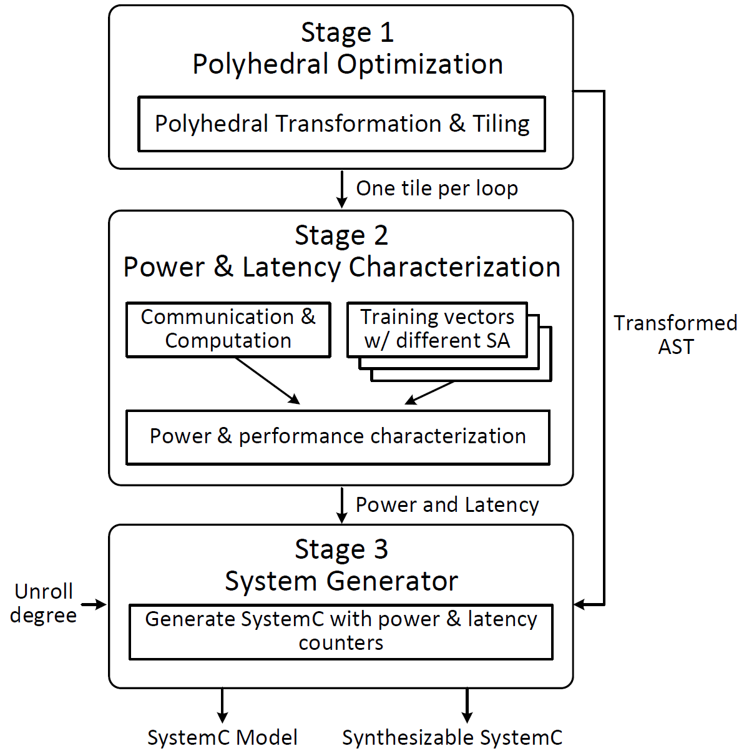
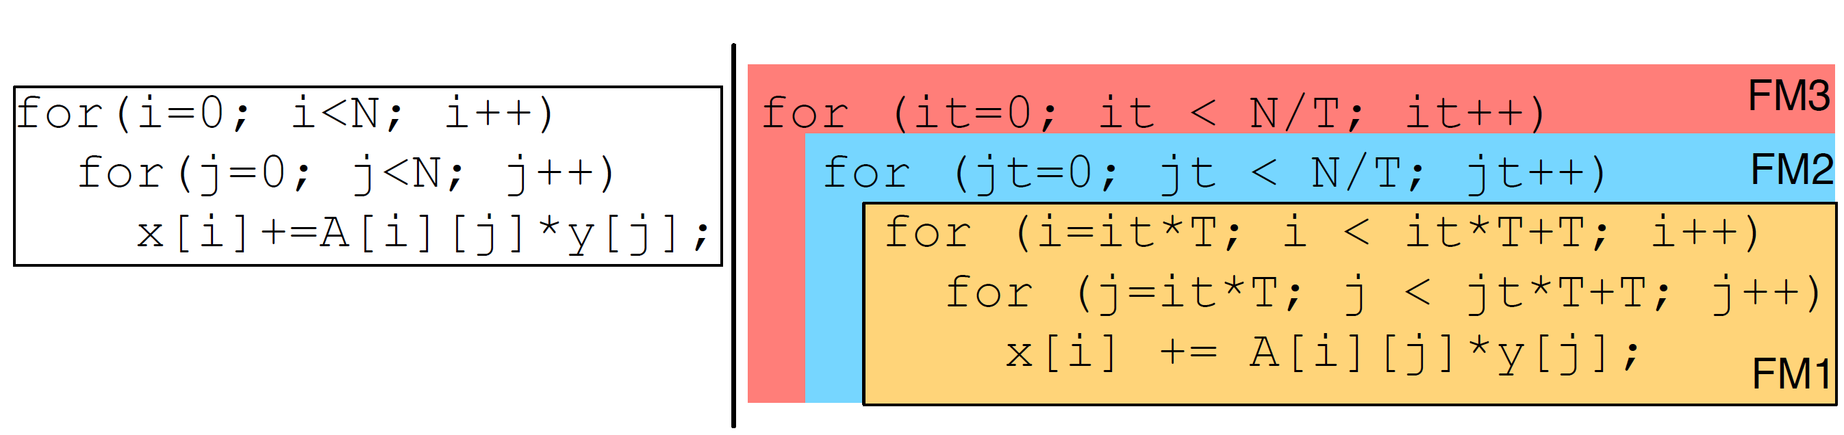
High-Level Power Modeling
Tile-based power modeling
Target: affine functions [Zuo et al, 2015]
Decompose the functions into tiles
Power characterization for tiles

Slide 12
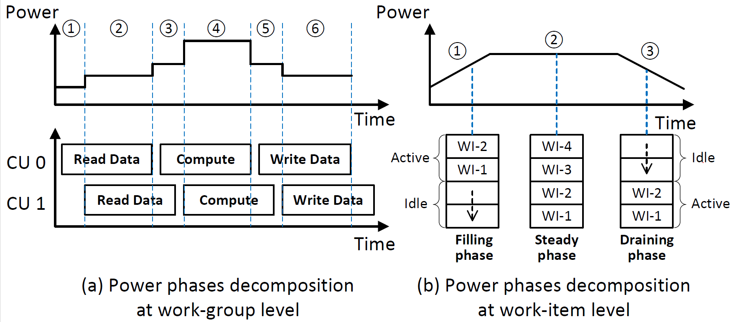
High-Level Power Modeling
Phase-based power modeling
Target: OpenCL
Work groups & work items in OpenCL [Liang et al, 2018]
Power phases in groups/items

Slide 13
Motivation
Problems of power modeling works
Long time for power characterization
Require hardware expertise
Dedicate to specific code structures/applications
High accuracy
Pre-RTL power modeling
High efficiency
High generalization ability

Slide 14
Outline
Introduction
Related Work
Power Modeling Framework
Design Space Exploration
Conclusion

Slide 15
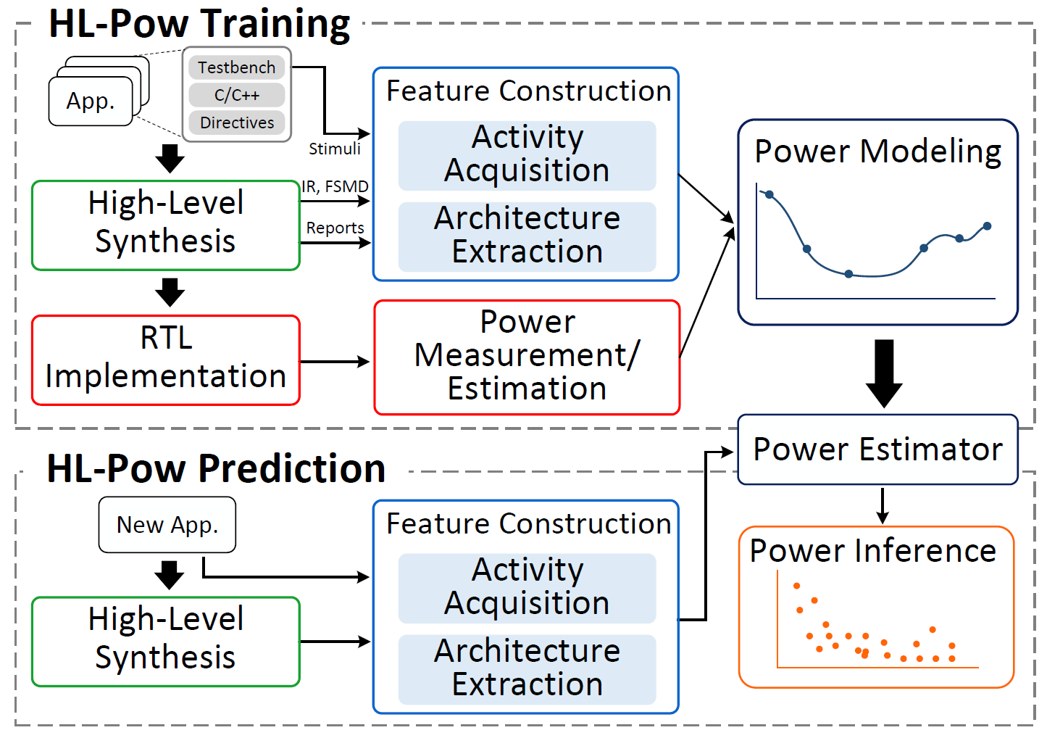
Overall Design Flow
Training phase
Collect training applications
Pass through HLS

Slide 16
Overall Design Flow
Training phase
Collect training applications
Pass through HLS
Feature construction

Slide 17
Overall Design Flow
Training phase
Collect training applications
Pass through HLS
Feature construction
RTL implementation
Collect ground truth power values

Slide 18
Overall Design Flow
Training phase
Collect training applications
Pass through HLS
Feature construction
RTL implementation
Collect ground truth power values
Power model training

Slide 19
Overall Design Flow
Training phase
Collect training applications
Pass through HLS
Feature construction
RTL implementation
Collect ground truth power values
Power model training
Prediction phase
Pass through HLS

Slide 20
Overall Design Flow
Training phase
Collect training applications
Pass through HLS
Feature construction
RTL implementation
Collect ground truth power values
Power model training
Prediction phase
Pass through HLS
Feature construction

Slide 21
Overall Design Flow
Training phase
Collect training applications
Pass through HLS
Feature construction
RTL implementation
Collect ground truth power values
Power model training
Prediction phase
Pass through HLS
Feature construction
Power inference

Slide 22
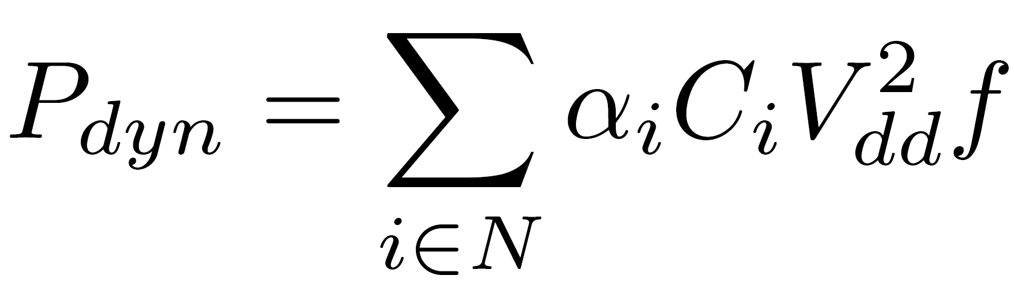
Data Collection
FPGA power decomposition
Static power: leakage power when the design is powered up, related to the scale of the design
Dynamic power: proportional to signal activity, capacitance, voltage and frequency
Data files collected from HLS for each design point
Overall design: HLS report (xxx.verbose.rpt.xml), IR code (a.o.3.bc)
Individual operator: IR operator information (xxx.adb), RTL operator information (xxx.adb.xml)

Slide 23
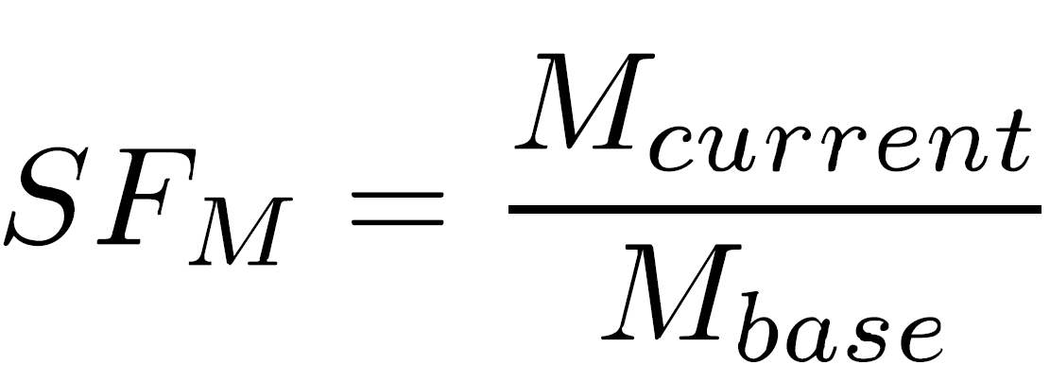
Feature Construction: Architecture Features
Resource Utilization
Look-up table (LUT)
Digital signal processing (DSP)
Flip-flop (FF)
Block random access memory (BRAM)
Performance
Latency in cycles
Frequency in nano-seconds
Scaling factors of metrics
Baseline design: the design point without any optimization
Normalize across different applications

Slide 24
Feature Construction: Activity Features
Conduct in high-level instead of gate-level
IR annotator: add activity tracking functions in IR
Activity generator: collect cycle-level activities
Histogram constructor: construct activity features
Testbench
Act track func lib
IR code
IR annotator
Activity generator
Histogram constructor
Activity features
IR op info
RTL op info

Slide 25
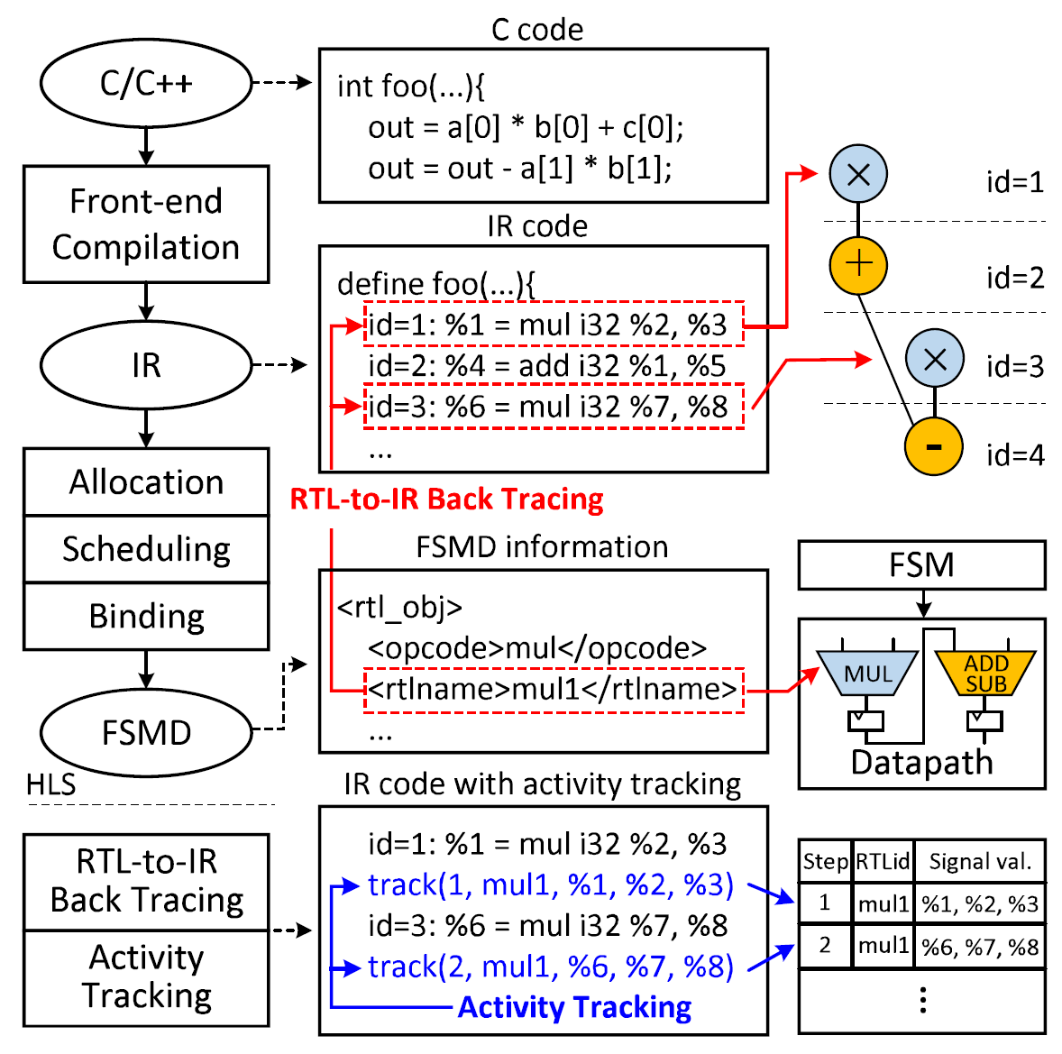
Activity Features: IR Annotator
Instrument the IR code with activity tracking functions for each RTL operator
IR operator: in IR code
RTL operator: in hardware
RTL-to-IR back tracing
Multiple IR ops one RTL op
Match IR ops to RTL ops by netlist name

Slide 26
Activity Features: IR Annotator
Instrument the IR code with activity tracking functions for each RTL operator
IR operator: in IR code
RTL operator: in hardware
RTL-to-IR back tracing
Multiple IR ops one RTL op
Match IR ops to RTL ops by netlist name
Activity tracking
Add activity tacking functions
Record cycle-level input/output + RTL op ID
Generate an annotated IR code

Slide 27
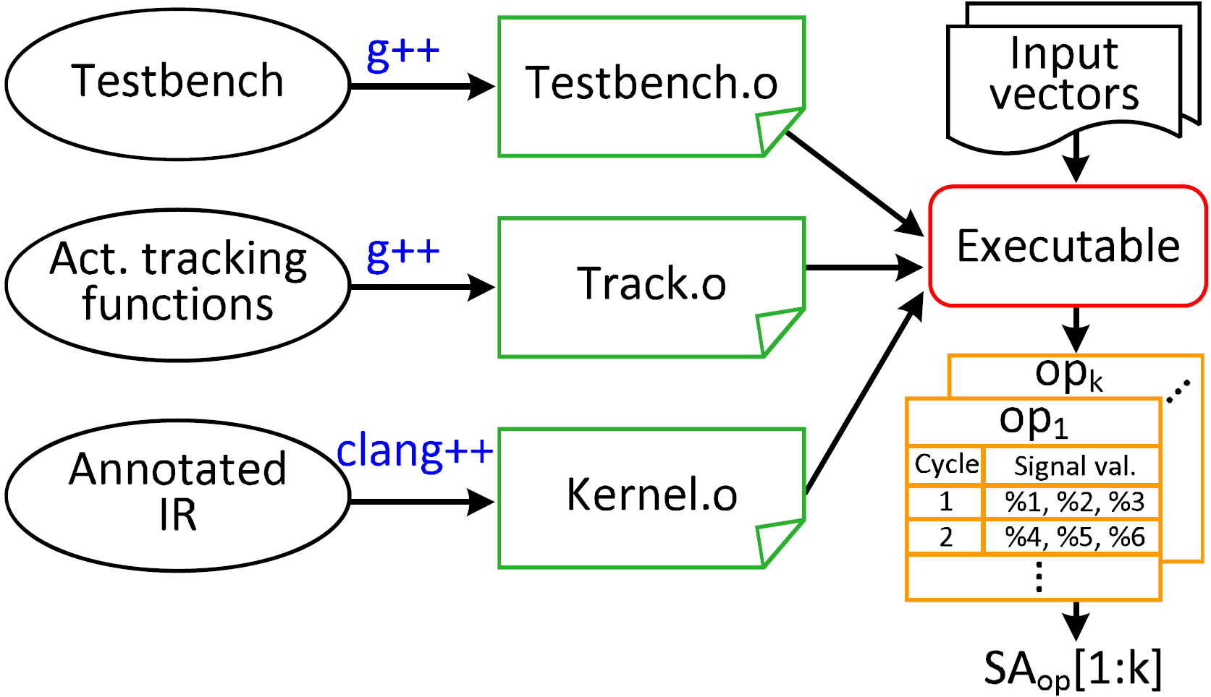
Activity Features: Activity Generator
Compute average activities of each RTL operator
Compile into link files (.o)
Combine, compile into executable
Run with input vectors
Create an activity table per RTL op

Slide 28
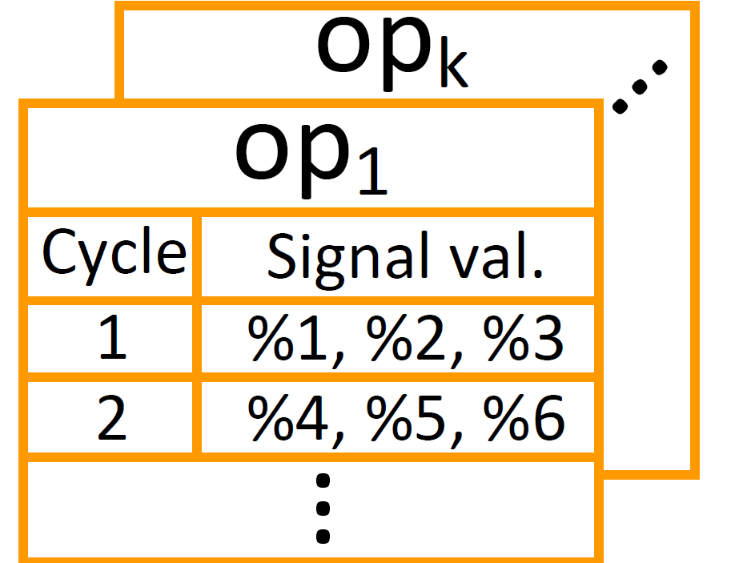
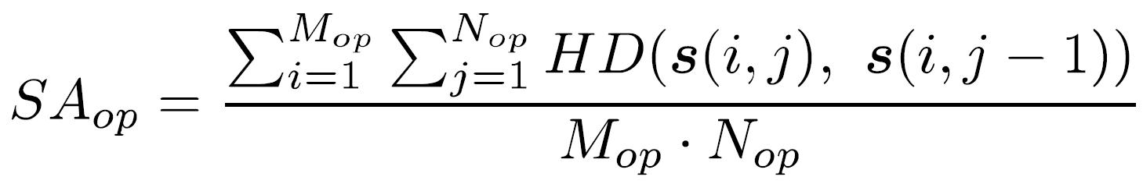
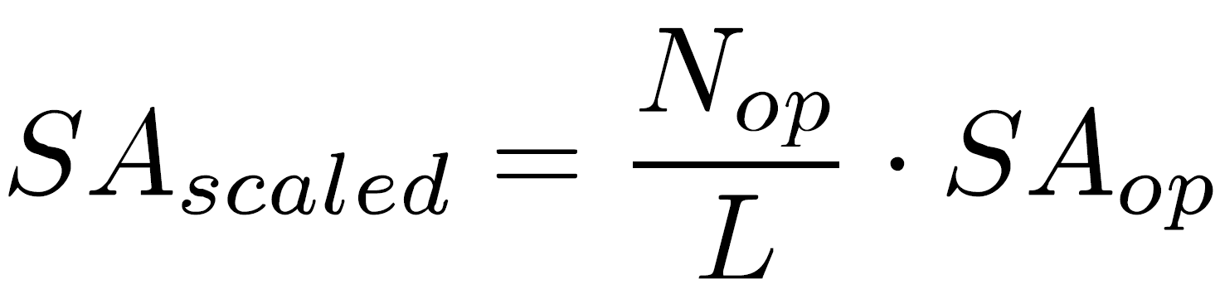
Activity Features: Activity Generator
Hamming distance: count differences bit by bit
Average the activity per RTL op
Amortize the activities over the total execution
Hamming distance
Avg. across cycles & operands
Op exe cycles / latency

Slide 29
Activity Features: Histogram Constructor
Operator activities → features
Fix the size of the feature set
Use a histogram representation
Allocate a histogram per opcode
Features per bin: #ops, percentage, average activity
+
+
Per-bin information
+1
SA: 2.2
# ops
percentage
+
+1
avg. activity
SA: 1.5
0
2
4
6
8
10

Slide 30
Power Modeling
256 features: 11 architecture features, 245 activity features
Ground truth power values through onboard measurement
Regression models
Linear regression: classic linear model, LASSO
Support vector machine (SVM): RBF kernel
Tree-based model: decision tree, ensemble model
Neural network: CNN, ResNet
Data normalization
Feature selection
Cross validation
Architecture features
16-by-16 mesh
Data normalization
Based on widely used instances
16
Activity features
16

Slide 31
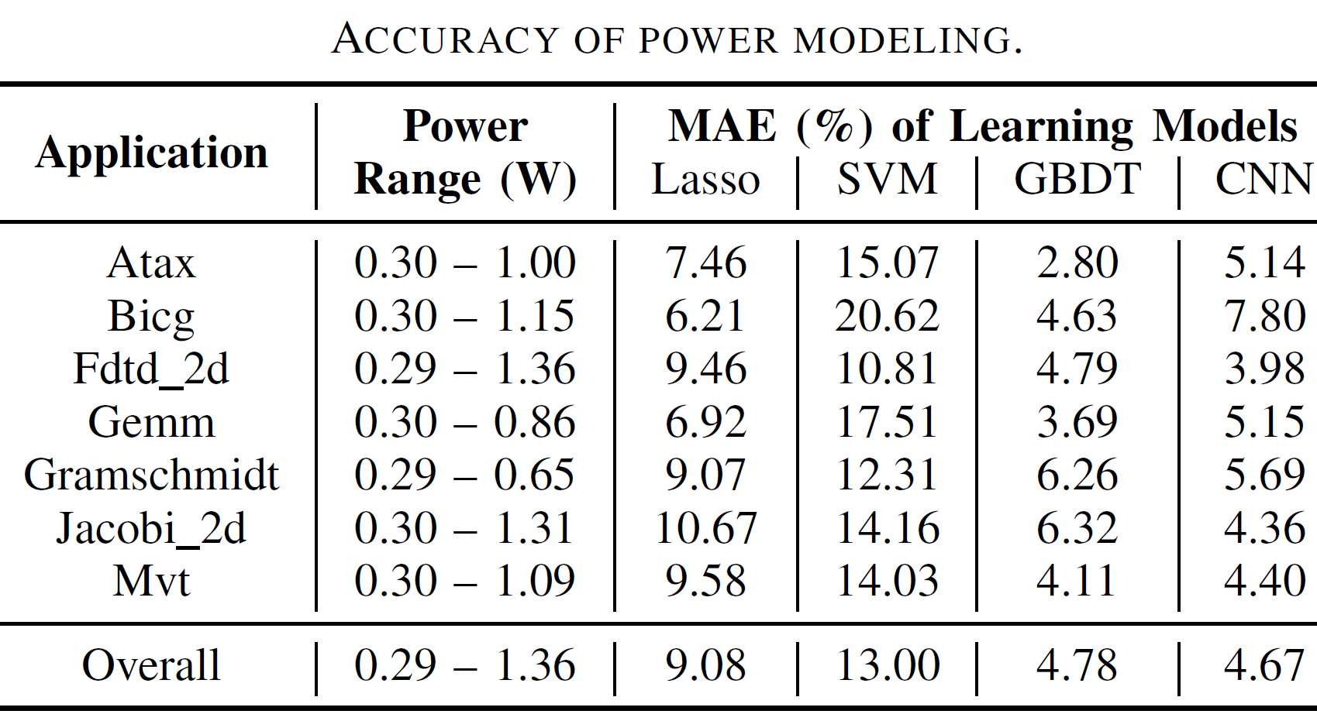
Experimental Results
Experimental setup
Training: 15 applications / 8784 design points
Testing: 6 applications / 2542 design points (> 20%)
Accuracy of power modeling
Show the best instance per type
Linear/SVM: ~10% test error
CNN: 4.67% test error

Slide 32
Outline
Introduction
Related Work
Power Modeling Framework
Design Space Exploration
Conclusion

Slide 33
Design Space Exploration (DSE)
Latency: by HLS
Power: by our power modeling flow (HL-Pow)
Trade off between latency and power
Brute-force DSE: HLS run-time overheads
To speed up DSE: design point sampling

Slide 34
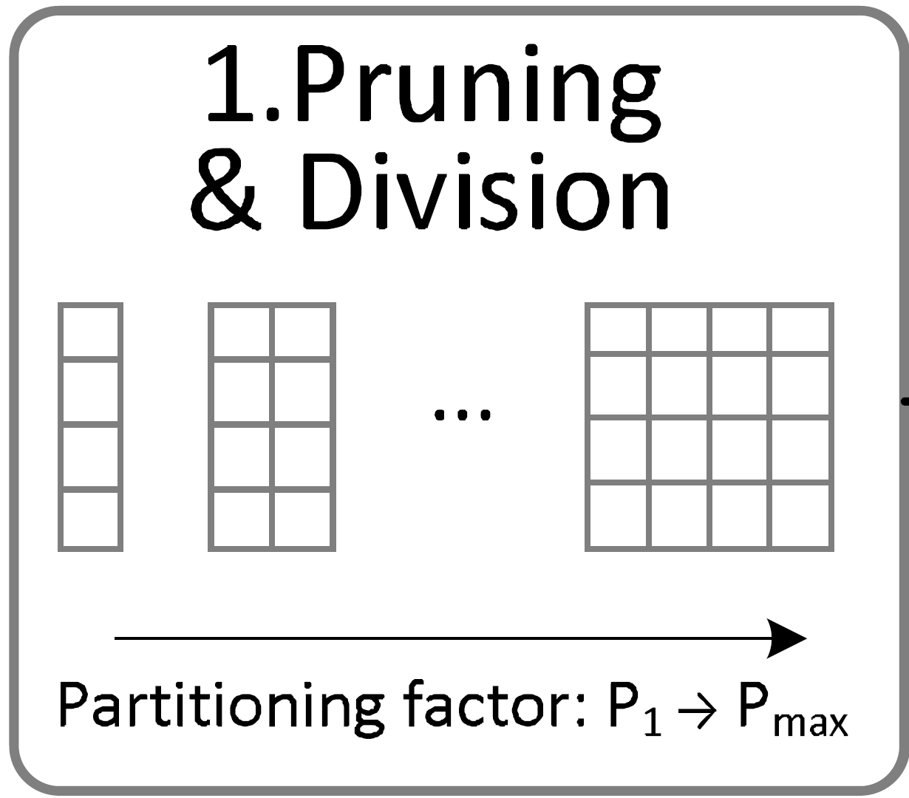
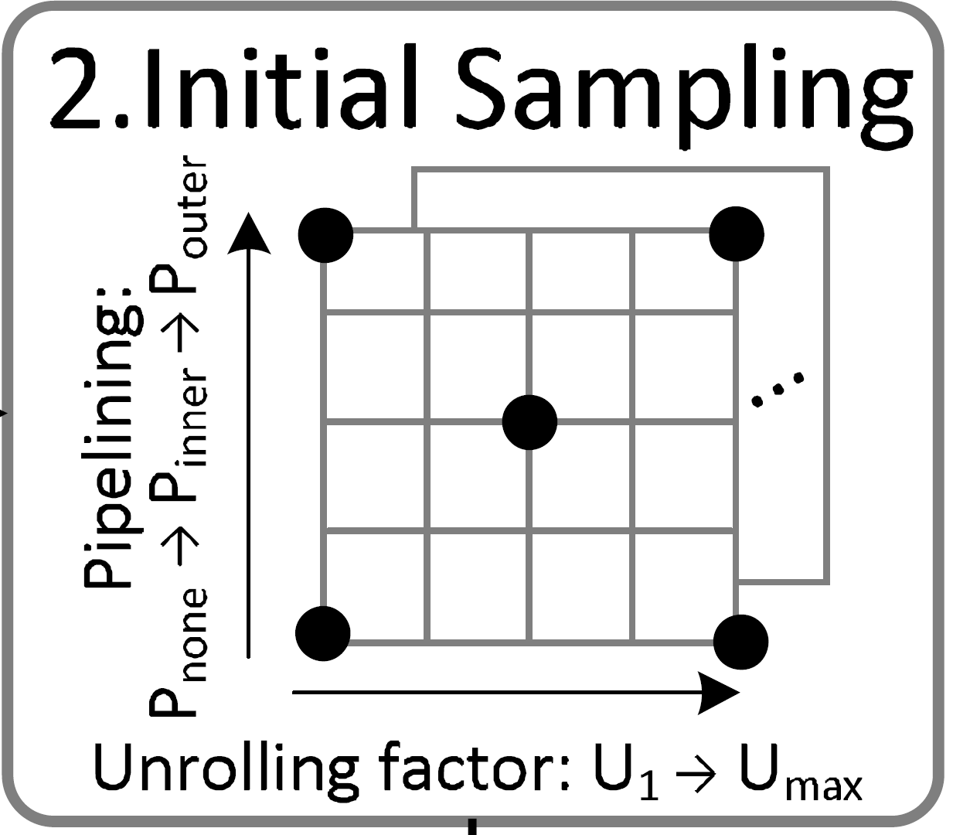
Design Space Exploration (DSE)
1. Design space pruning & division
Remove repetitive design points
Pipeline outer loop = unroll inner loops
Divide design space by partitioning factor
2. Initial sampling
Collect the first set of design points to assess
Power trend
Pipeline outer loop > pipeline inner loop > no pipeline
Large unrolling factor > small unrolling factor
Grid representation of unroll/pipeline
Select boundary and middle points

Slide 35
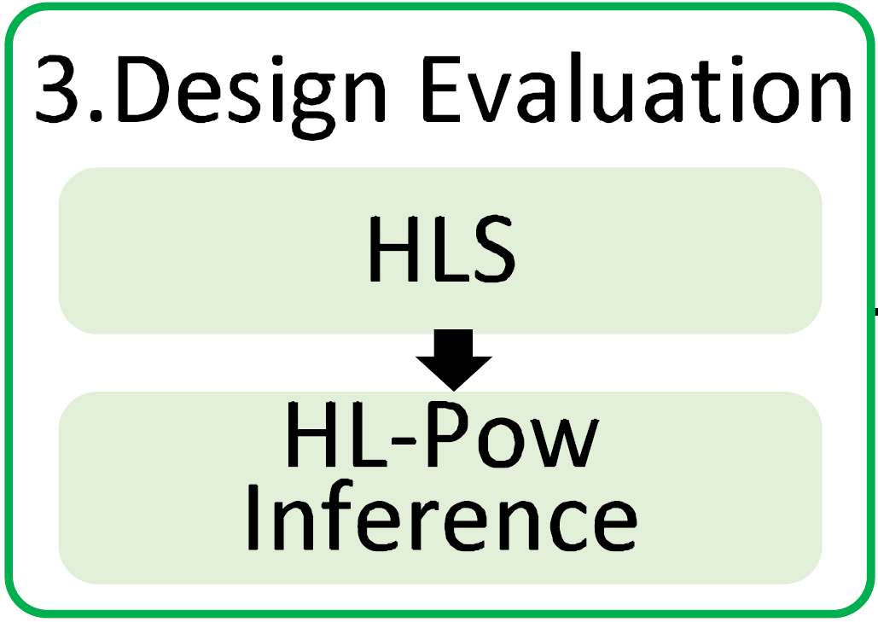
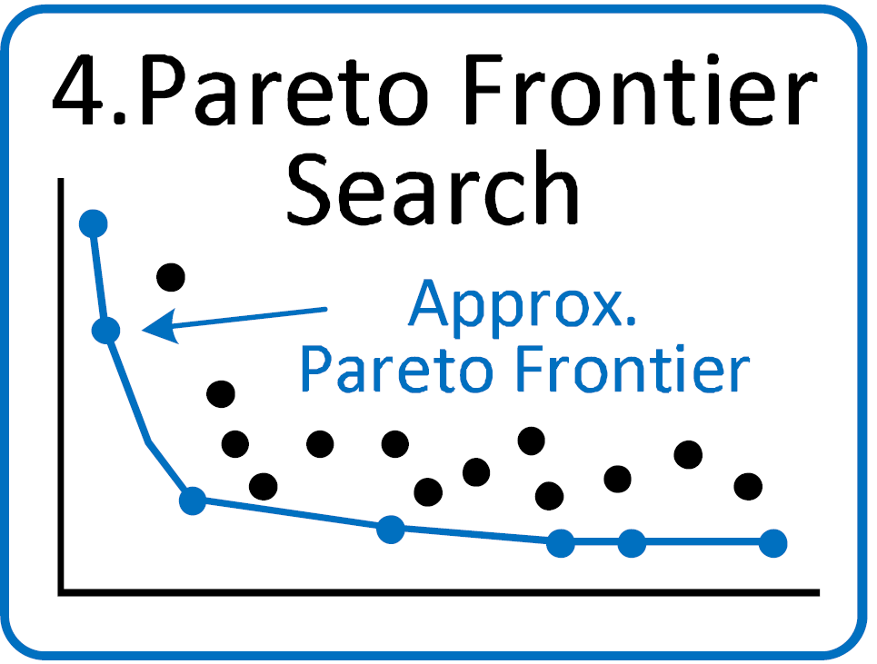
Design Space Exploration (DSE)
3. Design evaluation
Use HLS for latency evaluation
Use HL-Pow for fast power evaluation
4. Pareto frontier search
Approximate Pareto frontier from sampling points
Trade off between latency and power

Slide 36
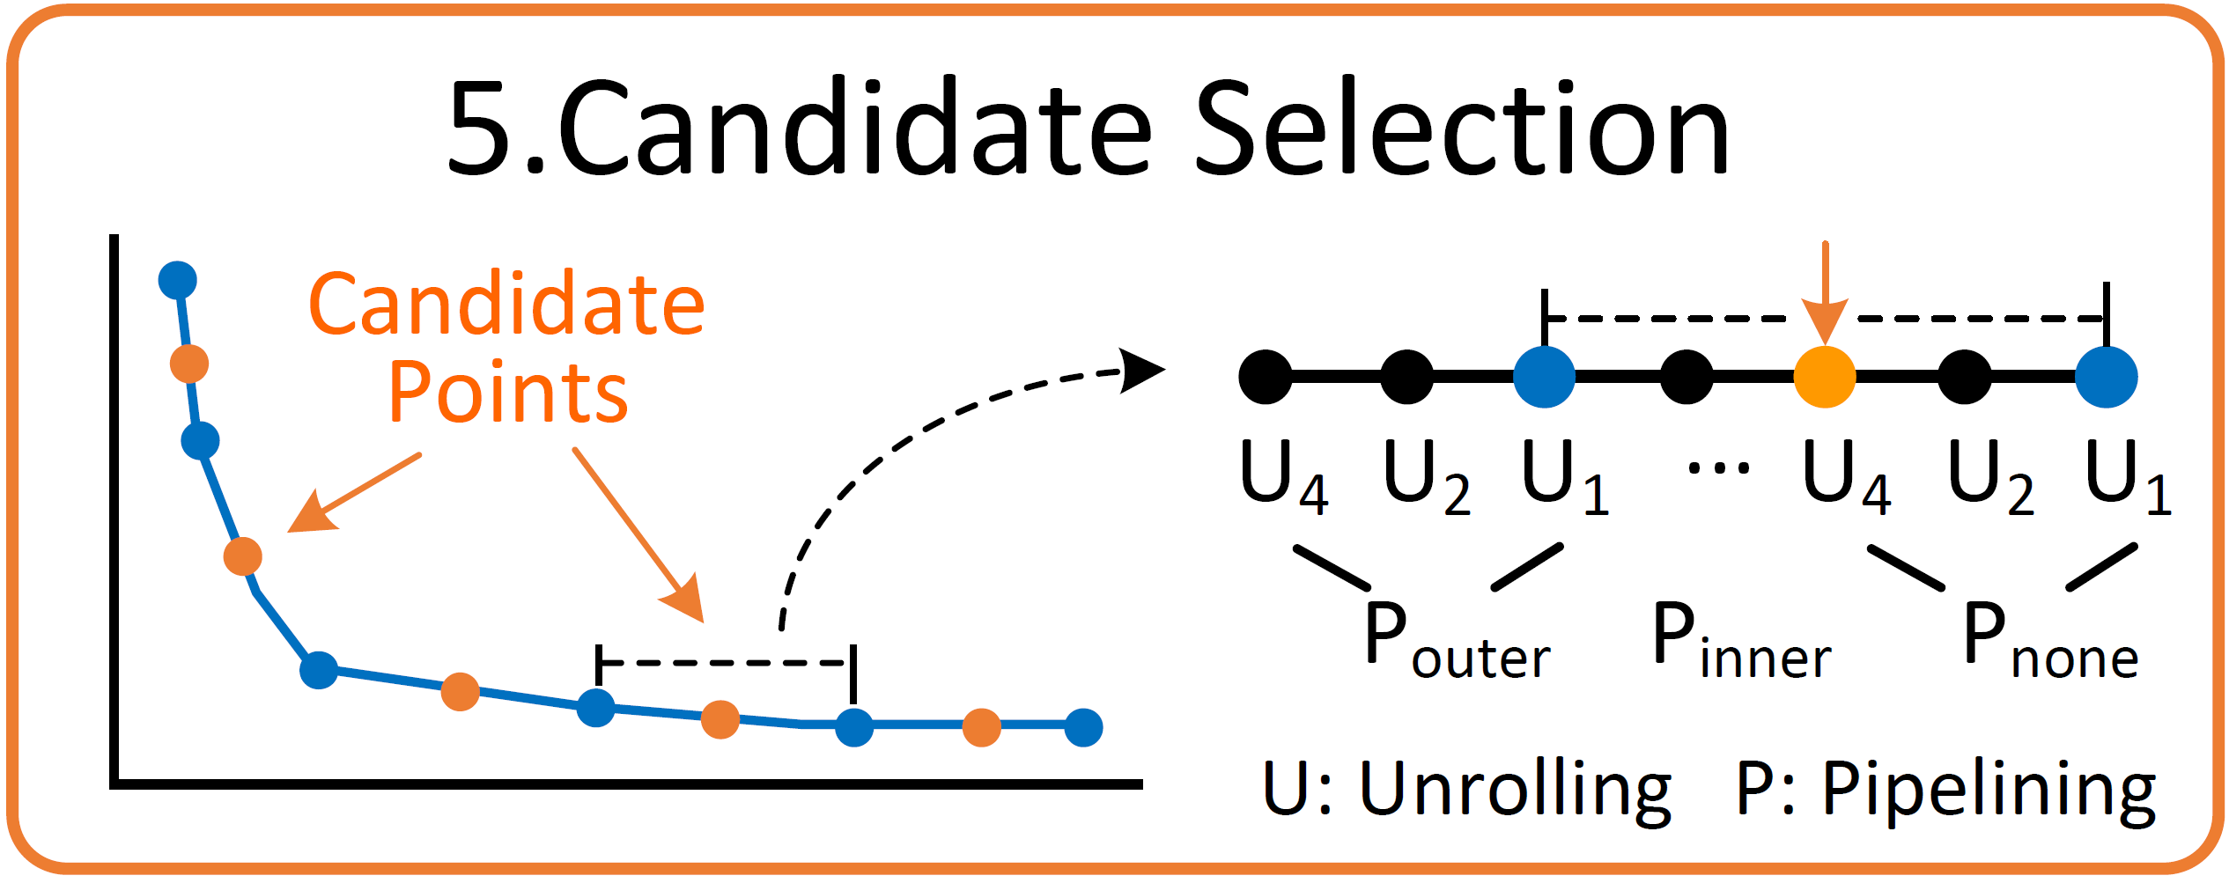
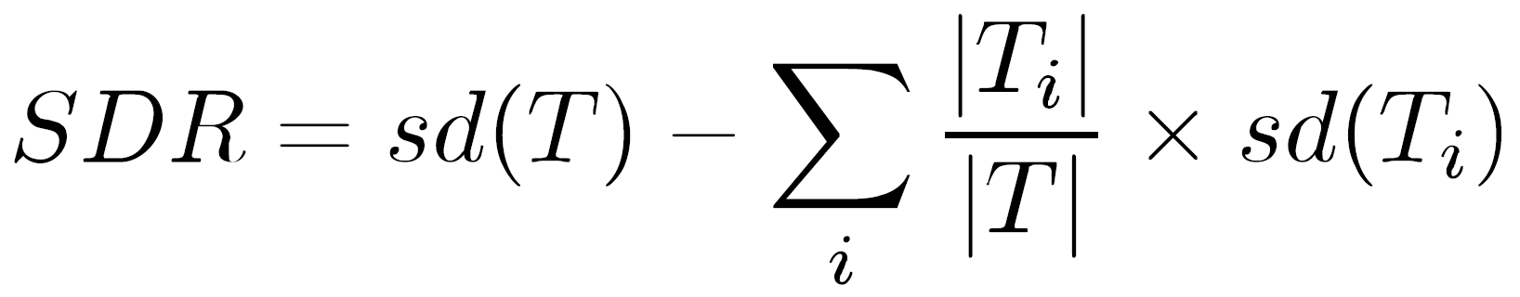
Design Space Exploration (DSE)
5. Candidate selection
Standard deviation reduction (SDR): the higher SDR, the larger impact
SDR: pipeline > unroll → latency/power impact: pipeline > unroll
Order sequence: first pipeline, second unroll
Select middle points of two pareto-optimal points

Slide 37
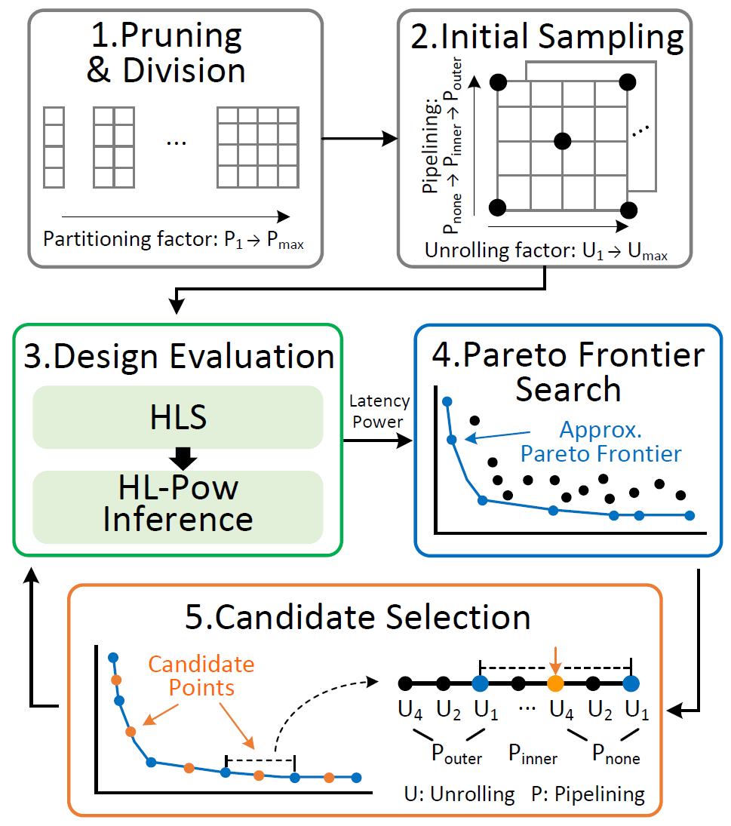
Design Space Exploration (DSE)
Algorithm decomposition
1. Design space pruning & division
2. Initial sampling
3. Design evaluation
4. Pareto frontier search
5. Candidate selection
iterate

Slide 38

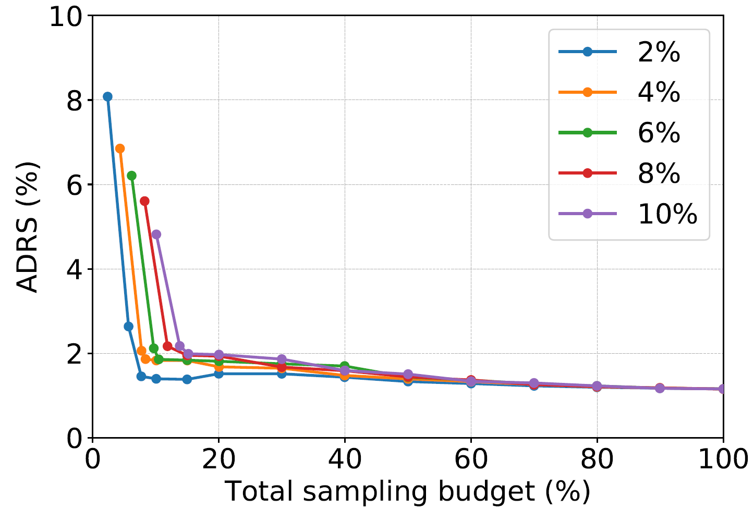
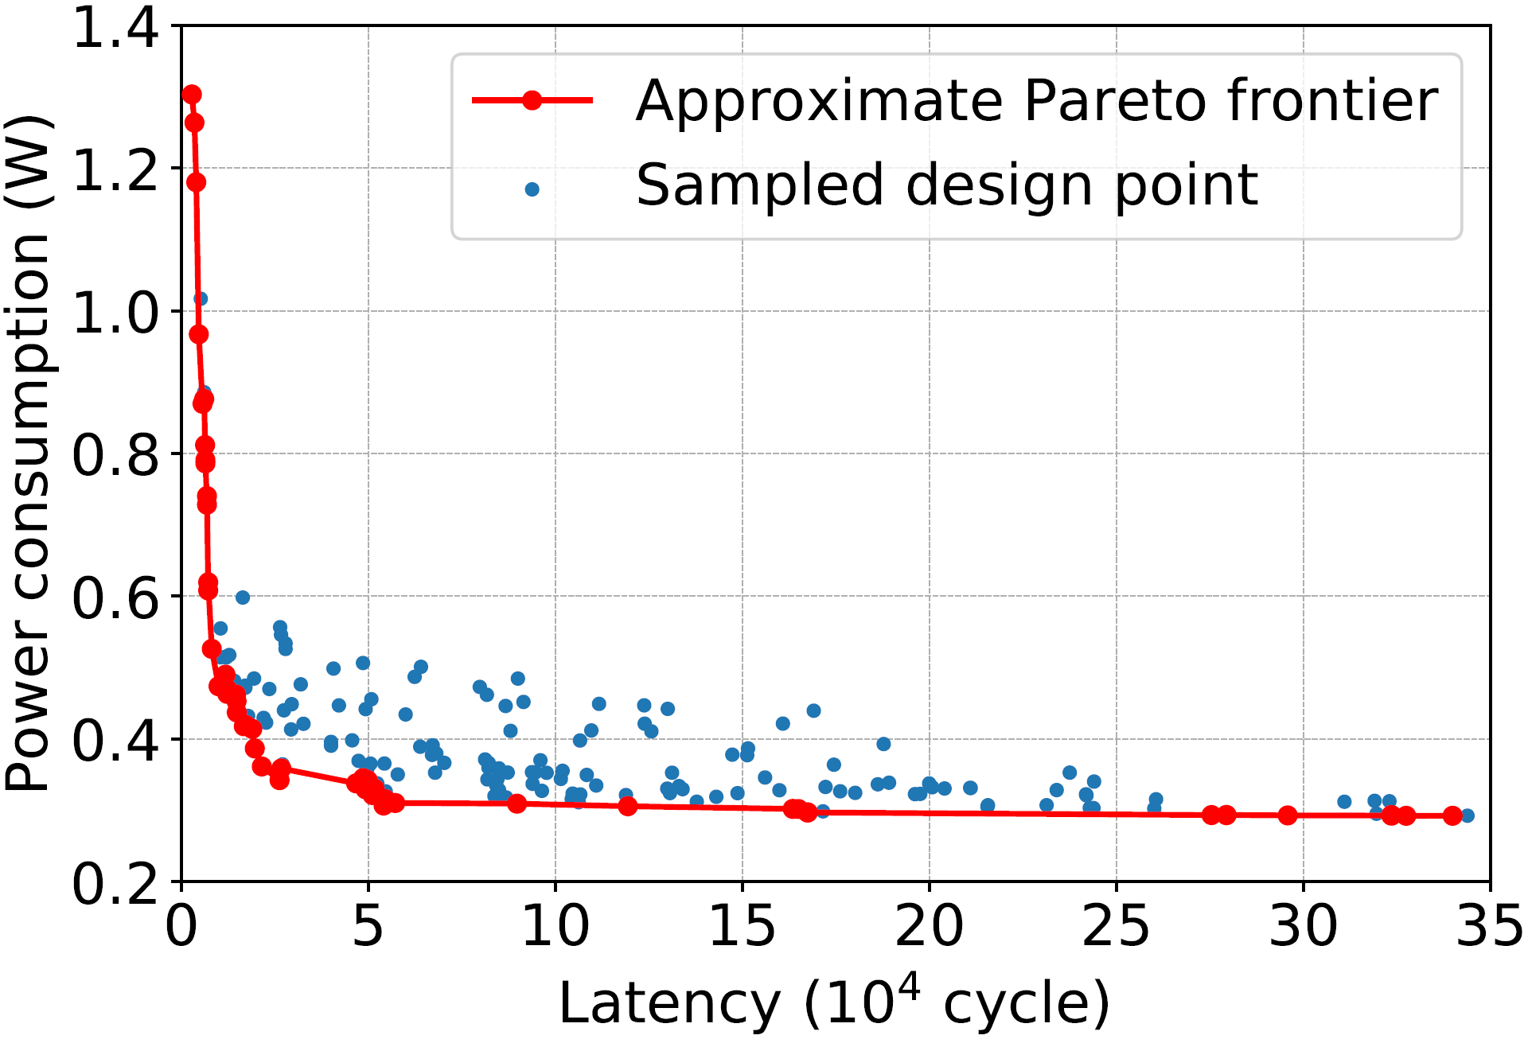
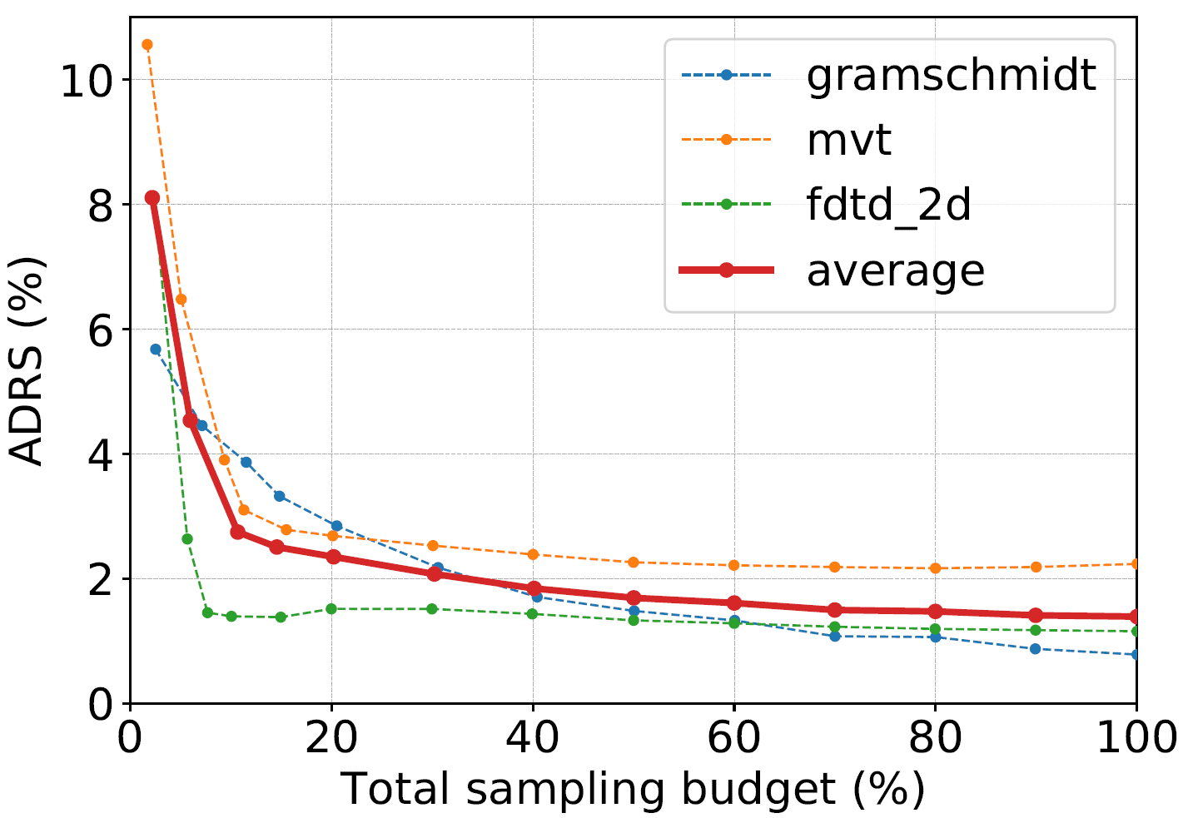
Experimental Results
Initial sampling rates
Design space exploration
Metric: average distance to reference set (ADRS), to see how close two Pareto set is
Initial sampling rates: different rates converge, but a small rate benefits small sampling budgets
Total sampling budgets:
20%: ADRS = 2.35%
40%: ADRS = 1.84%
ADRS decreases rapidly as the sampling budget increases from the start
Sampling budgets
Initial sampling rate = 2%
Sampling budget = 20%

Slide 39
Outline
Introduction
Related Work
Power Modeling Framework
Design Space Exploration
Conclusion

Slide 40
Conclusion
HL-Pow: HLS power modeling
Early-stage
Accurate
Fast
High generalization ability
Power-oriented DSE
Characteristics of HLS directives
Trim down design space
Iterative search flow

Slide 41
THANK YOU
Q & A

Slide 42
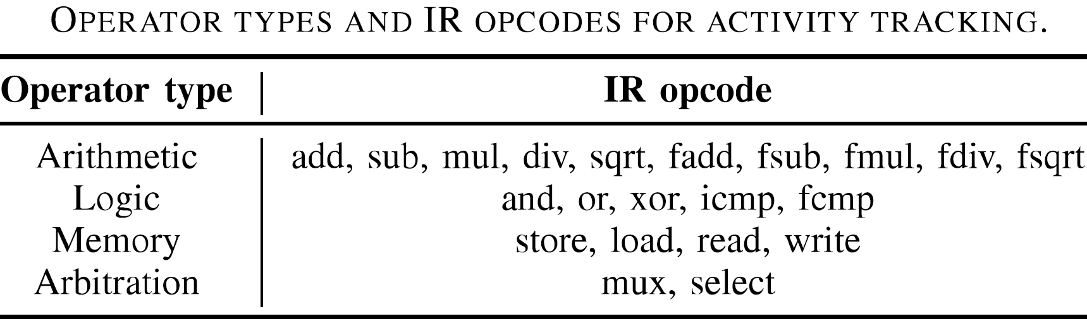
Operator type

Slide 43
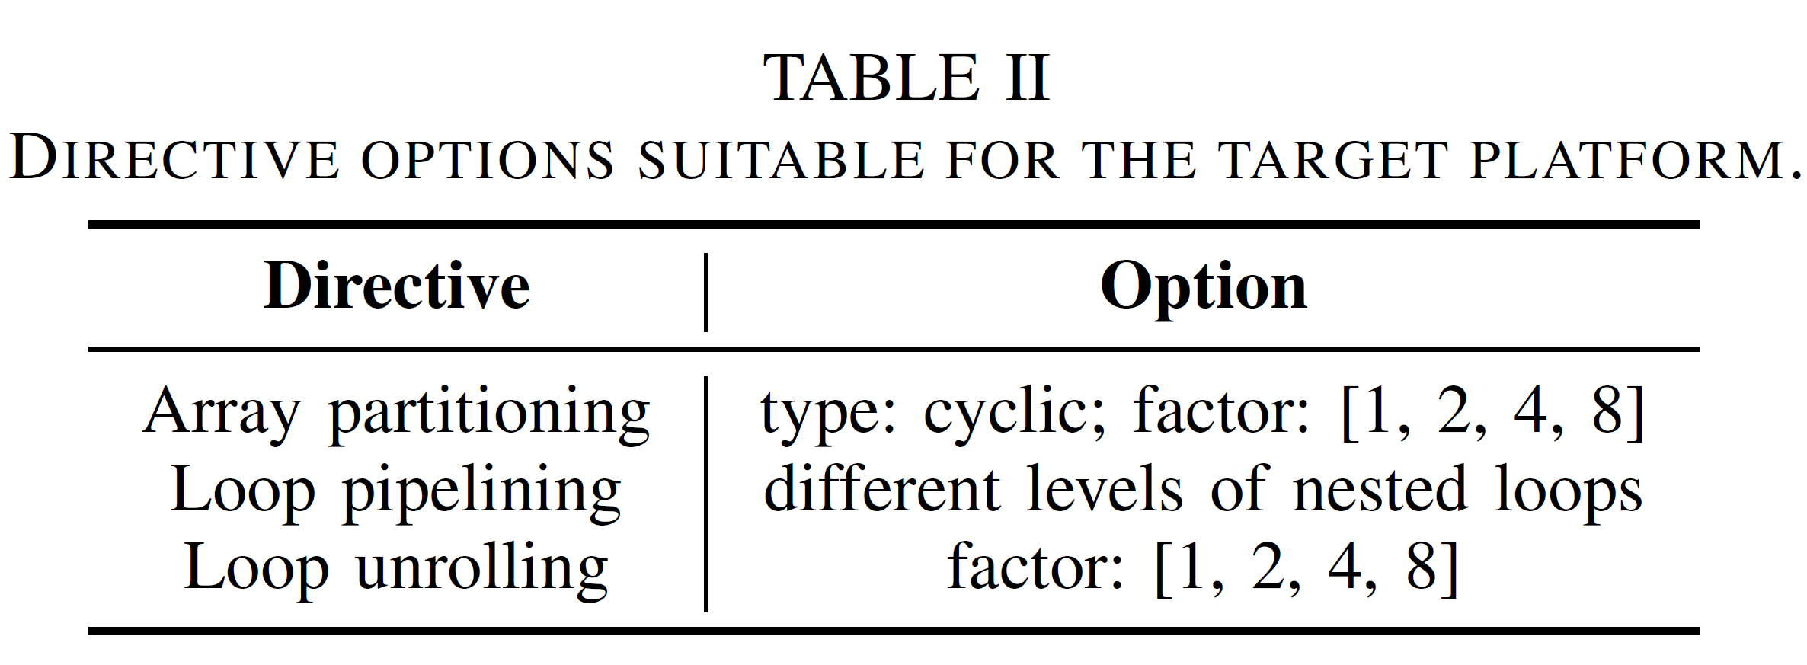
Directive

Slide 44
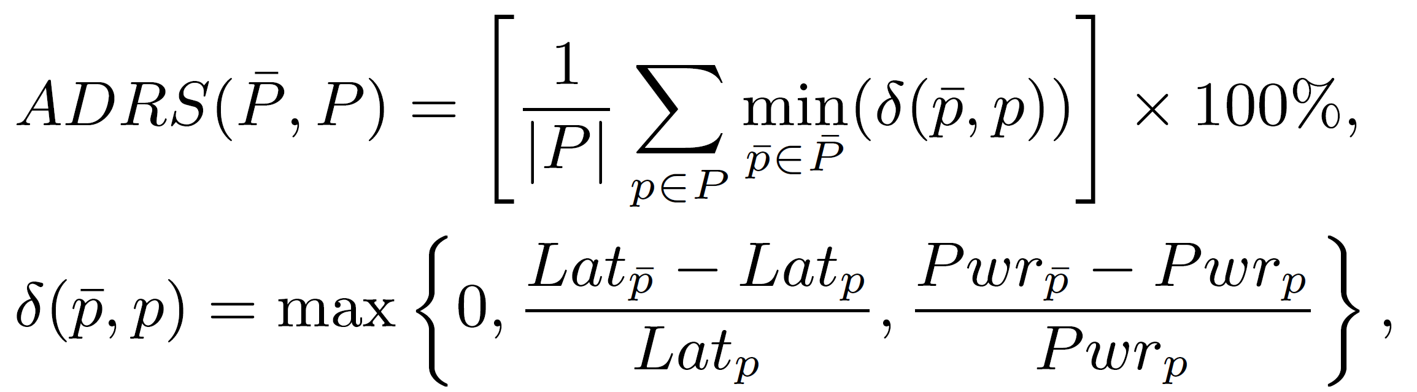
ADRS

